Slide 1
Photos of Route 6 Bridge Strike and Repair

Slide 2
Route 6 Bridge Strike
Wednesday, June 12, 2024 – Bridge Strike
Route 6 Truss Bridge over Sugar Creek in Troy Township, Bradford County

Slide 3
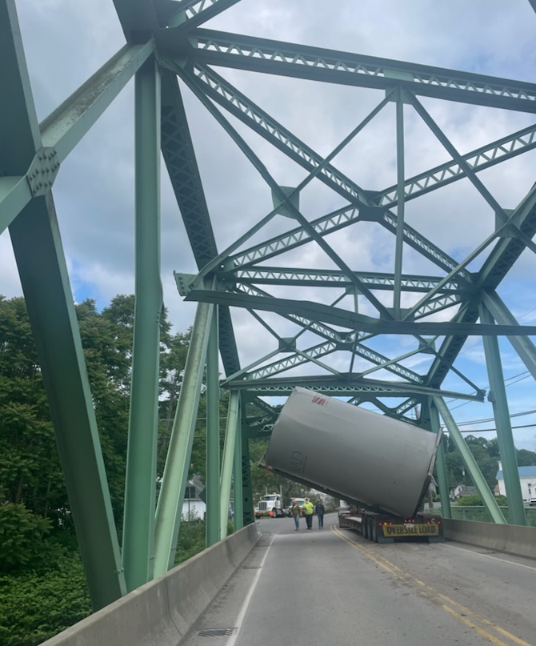
Route 6 Bridge Strike
Wednesday, June 12, 2024 – Bridge Strike
Route 6 Truss Bridge over Sugar Creek in Troy Township, Bradford County

Slide 4
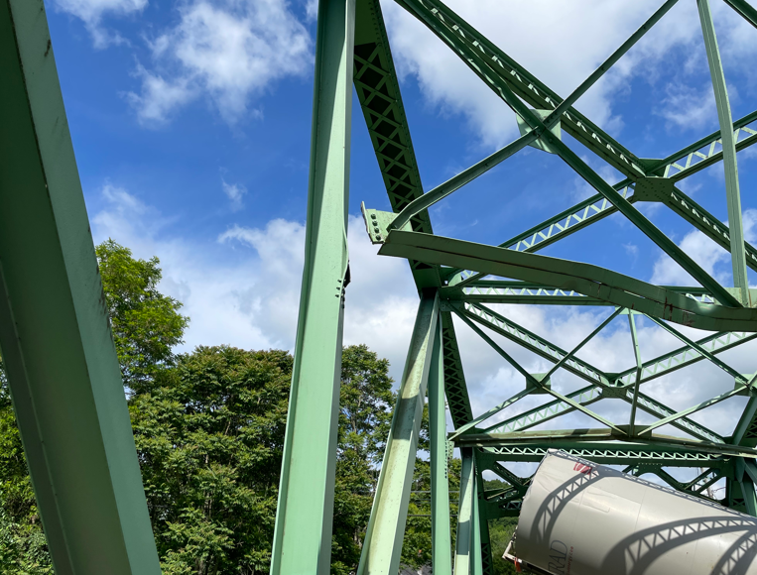
Route 6 Bridge Strike
Wednesday, June 12, 2024 – Bridge Strike
Damaged steel members
Route 6 Truss Bridge over Sugar Creek in Troy Township, Bradford County

Slide 5
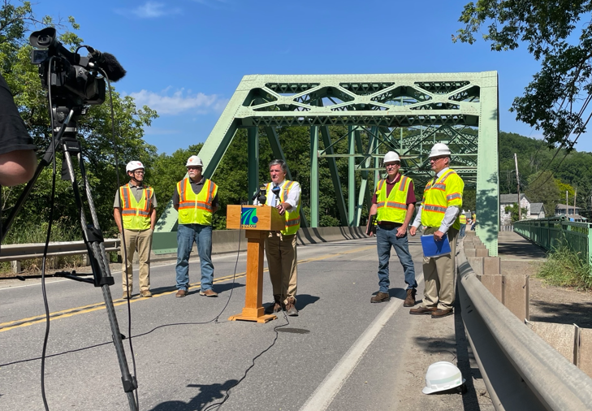
Route 6 Bridge Strike
On Monday, June 17, 2024, PennDOT officials along with industry partners provided a update on plans to repair the damaged bridge in Troy Township, Bradford County.
“We know that Route 6 is a crucial highway to the people of Bradford County and the region, and fully reopening this road is just as important to PennDOT and Governor Shapiro as it was for I-95 in Philadelphia,” said PennDOT Secretary Mike Carroll. “We’re working to get this bridge restored and Route 6 reopened as quickly as possible.”
“We will advance the project as quickly as possible,” said District Executive Eric High. “Our goal is to have this completed and reopened by the end of August, but that is highly variable at this point and depends on when we can secure the needed materials to make the repairs.”

Slide 6
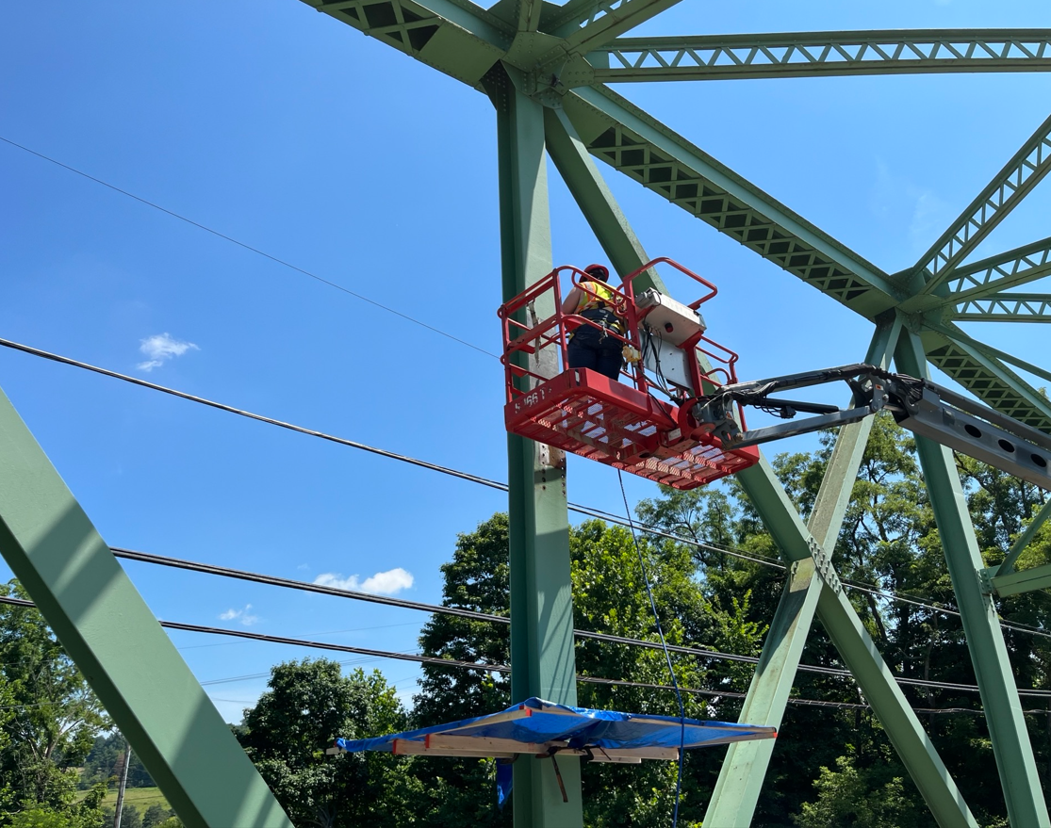
Route 6 Bridge Repair
Monday, July 8 and Tuesday, July 9
Heat straightening work
Route 6 Truss Bridge over Sugar Creek in Troy Township, Bradford County

Slide 7
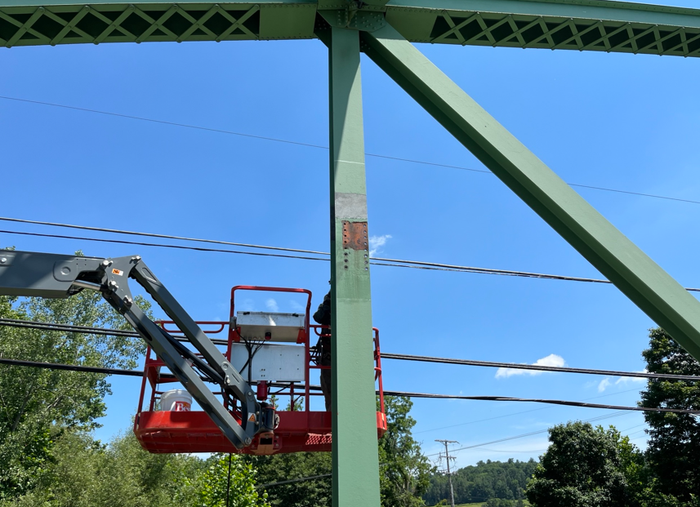
Route 6 Bridge Repair
Monday, July 8 and Tuesday, July 9
Heat straightening work
Route 6 Truss Bridge over Sugar Creek in Troy Township, Bradford County

Slide 8
Route 6 Bridge Repair
Monday, July 8 and Tuesday, July 9
Removal of damaged steel members
Route 6 Truss Bridge over Sugar Creek in Troy Township, Bradford County

