Slide 1
Drive Electric PA Coalition Meeting
Friday, March 27
via Webex

Slide 2
Alt Fuels Corridor DEPLOYMENT PLAN
Ngani Ndimbie, PennDOT & Dan SZEKERES, MBI

Slide 3
Alternative fuels corridor program

Slide 4
CORRIDOR EV CRITERIA

Slide 5
FHWA Deployment Plan GoalS
Applied Research Funding Opportunity (State DOTs & MPOs)
Focus on Interstate Corridors
Focus on Filling Gaps and Designation as “Ready” Corridor
Focus on Exploring Public-Private Partnerships

Slide 6
Deployment Plan Tasks
BUILDS OFF ROADMAP STRATEGIES
PLAN TASKS
Corridor Assessment
Outreach and Engagement
Site Feasibility Assessment
Action Plan
Share Lessons Learned (FHWA Pilot)

Slide 7
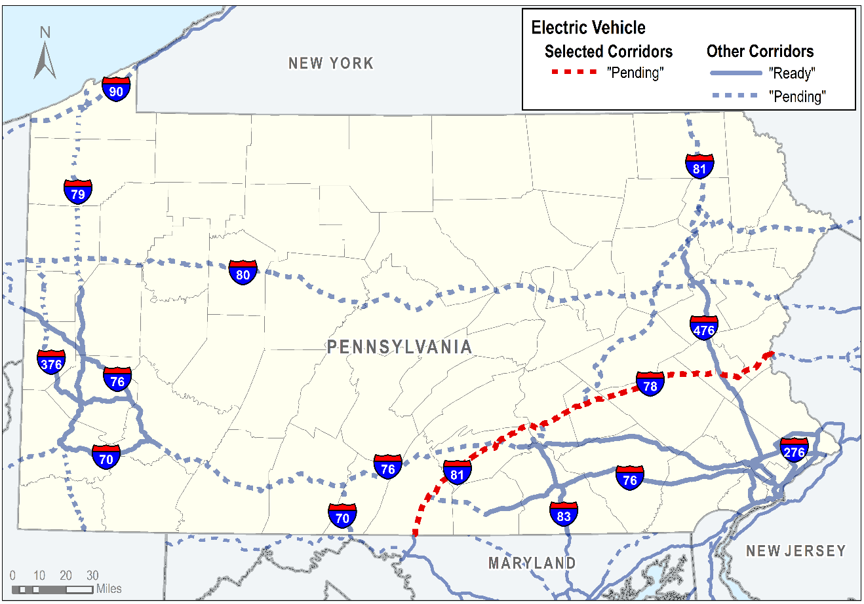
SELECTED corridor

Slide 8
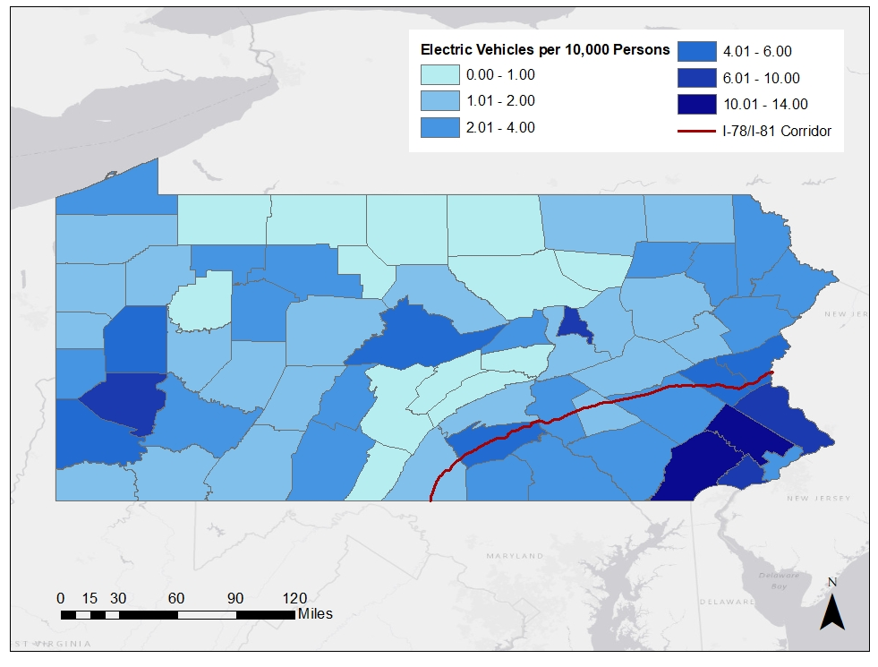
Baseline Assessment
Current Charging Infrastructure
Travel Characteristics
Development Potential
Utility Infrastructure
AFIG Applications
EXISTING EV REGISTRATIONS PER CAPITA BY COUNTY

Slide 9
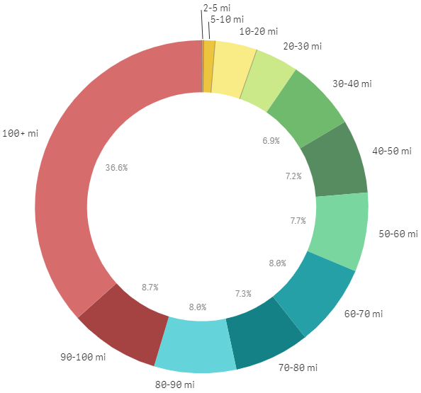
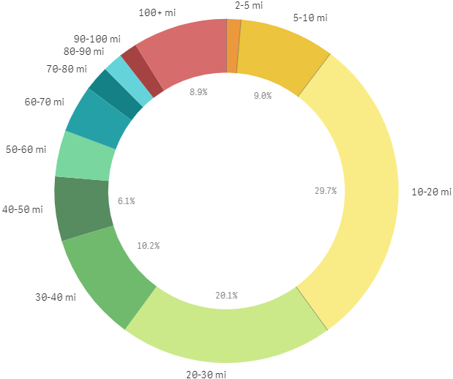
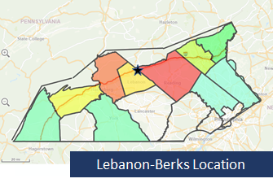
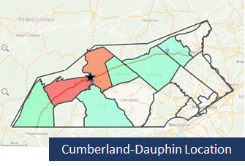
Evaluating Corridor Travel
Average Travel Time
Trip Purpose

Slide 10
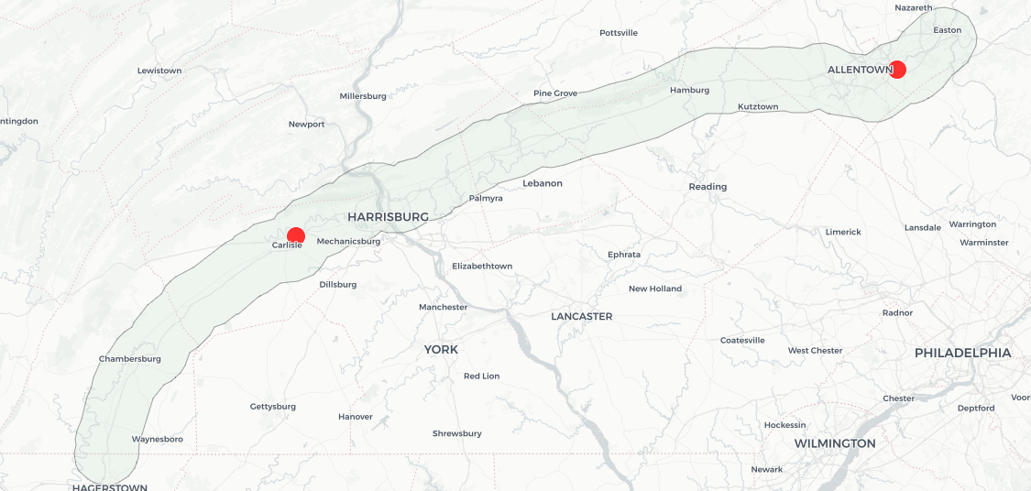
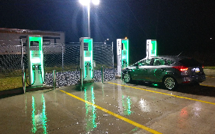
CORRIDOR Gap Analysis
Only Two Locations Currently Qualify with Both Connector Types (CCS, CHAdeMO)
Greenlots
Lehigh Univ. Campus
Faculty, Students, Visitors
GAP>50Mi
Sheetz 191 Carlisle PA
GAP>50Mi

Slide 11
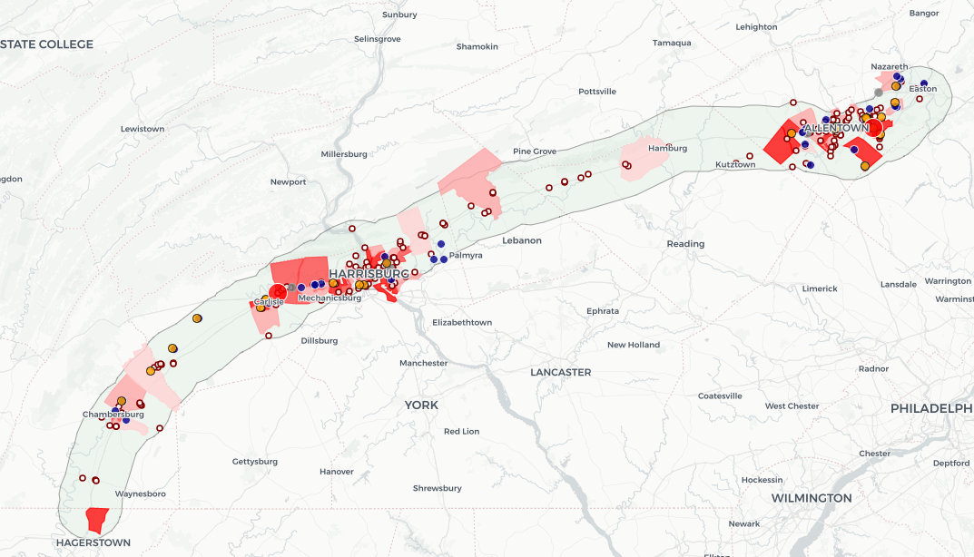
CORRIDOR Gap Analysis
Other Potential Sites (March 2020) To Guide Outreach and Partnerships
DC Fast Charge Sites with CCCS & CHAdeMO Connectors
Other DC Fast Charge Sites
Driving PA Forward Sites (In Progress)
Other Service Stations
Areas of Higher Job Density
Project Mapping:
https://tmp-map.s3.amazonaws.com/dot/alt-fuel/i81-i78-alt-fuel.html

Slide 12
Addressing The Gaps
Outreach and Engagement
Identify the opportunities and barriers.
Conduct targeted outreach to specific commercial and municipal fleets to determine interest in alternative fuels, needs and issues.
Discuss public marketing strategies to increase awareness of alternative refueling locations and increase vehicle usage.
Discuss funding opportunities and grant programs to support infrastructure development.
Identify commercial stakeholders and work to identify the potential for private partnerships within the corridor.

Slide 13
Can Drive Electric pA Help?
Identify Barriers Encountered
Examples of Commercial Partnerships
Funding Opportunities Like AFIG
Innovative Ideas (e.g. hubs for charging and EV carsharing)
Role of Utility Companies
Technical Assistance for Installing Chargers
Marketing Strategies

